Slide 1
PROJECT
REPORT
Nikhil Samuel Joseph J
. Internship ID: UMIP19644
Domain: Machine Learning

Slide 2
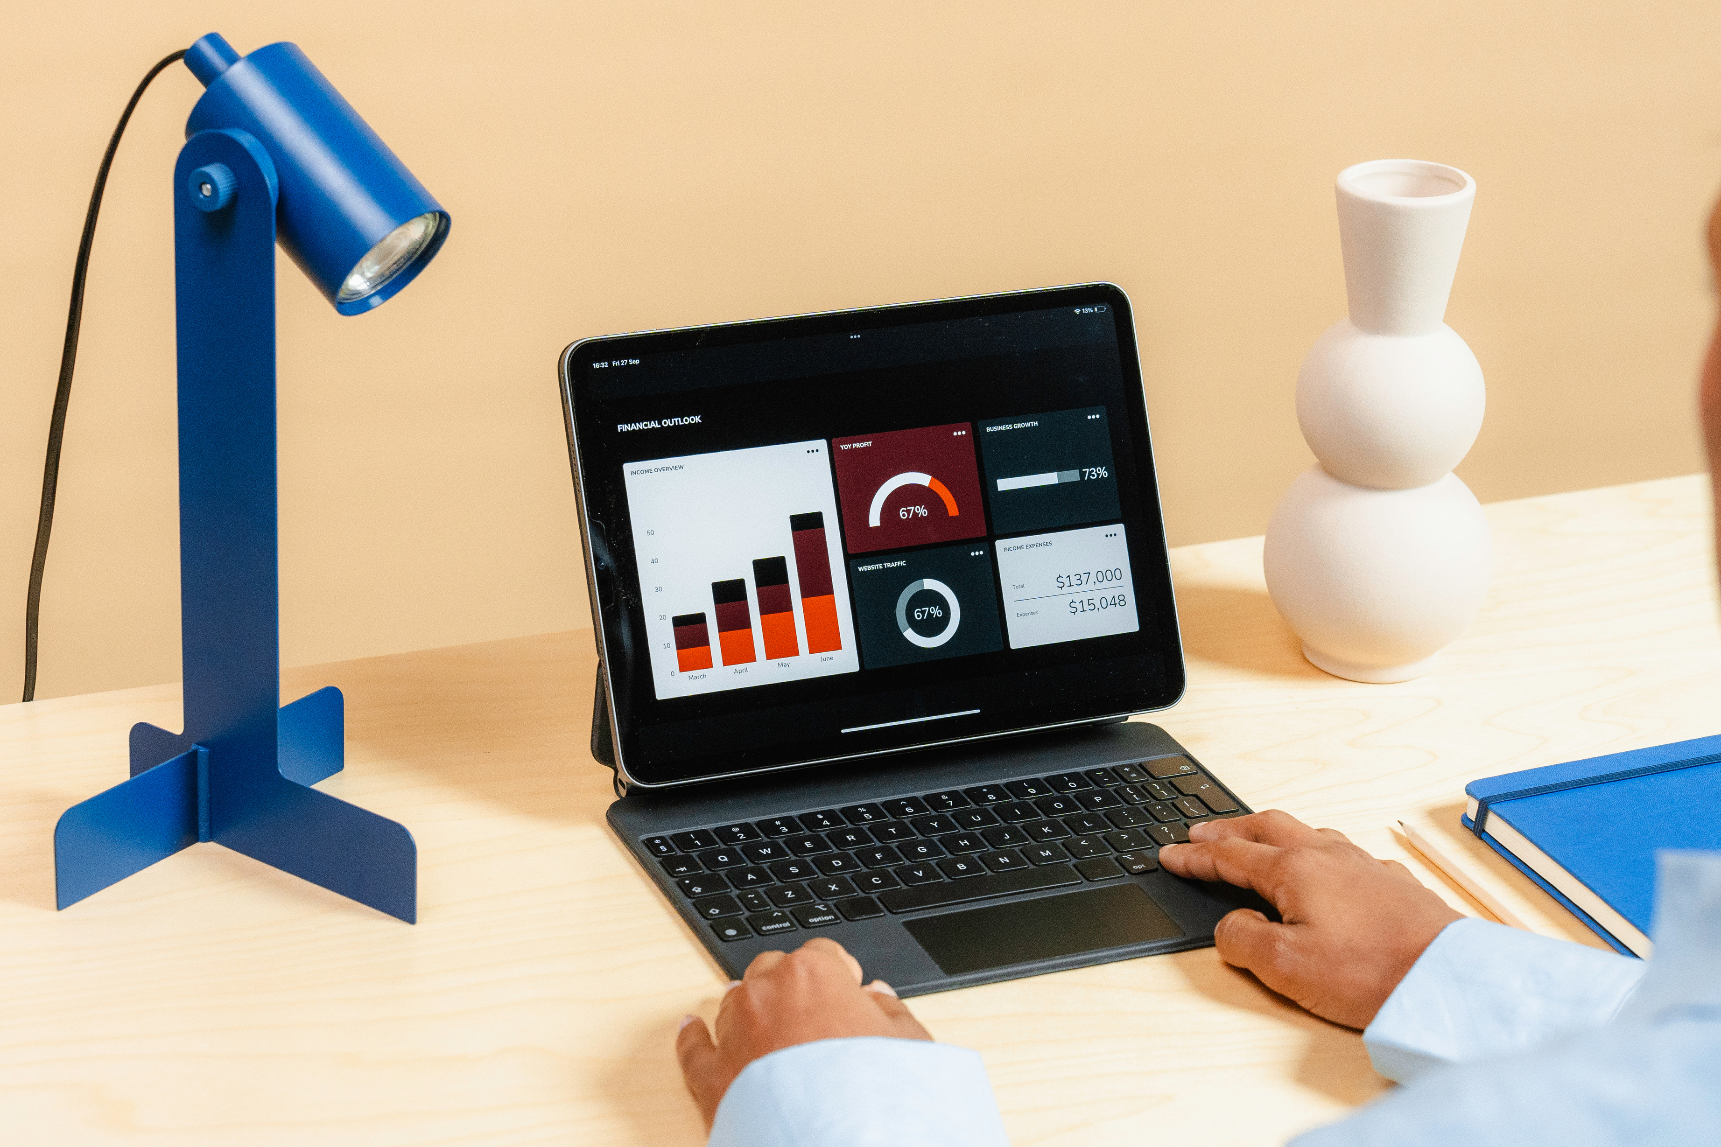
TOPICS CHOSEN
Animal Classification
Heart Disease Detection
Mobile Phone Pricing Prediction
Vehicle Prices Prediction

Slide 3
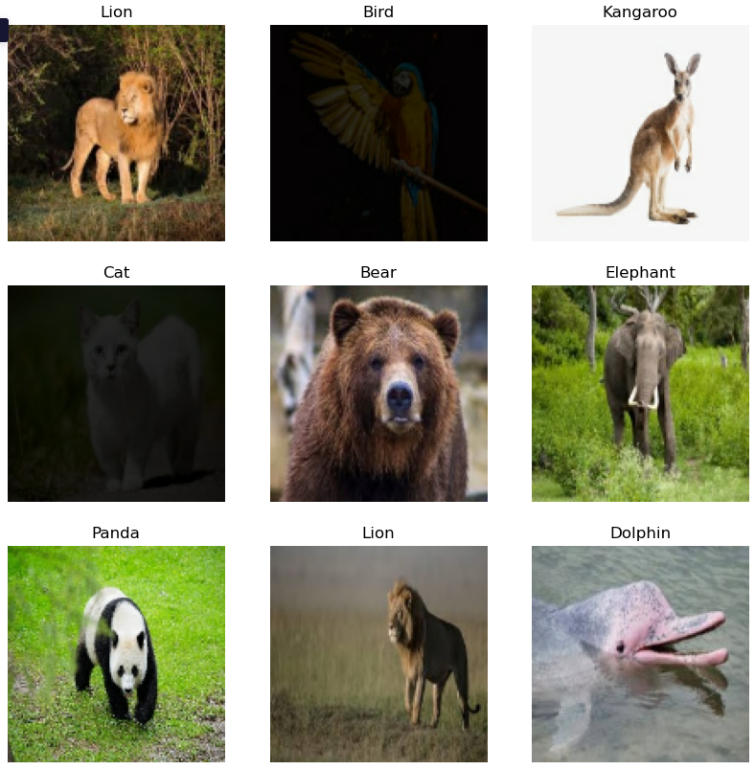
Animal Classification
Creating a CNN model to classify animals based on the image.
'Bear', 'Bird', 'Cat', 'Cow', 'Deer', 'Dog', 'Dolphin', 'Elephant', 'Giraffe', 'Horse', 'Kangaroo', 'Lion', 'Panda', 'Tiger', and 'Zebra’ are animals that are needed to be classified.

Slide 4
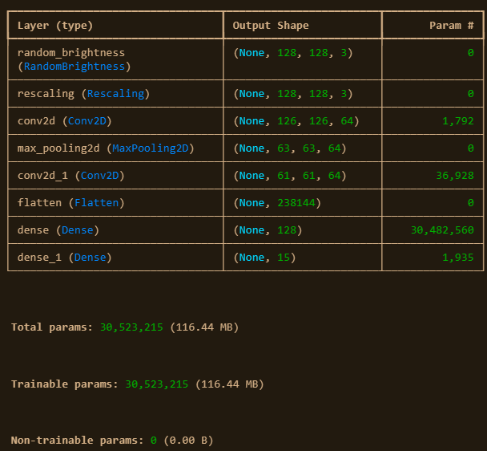

Model Architecture
Created a random_brightness layer and rescaling layer to avoid overfitting and make it easier for the neural network to process the image.
Two Convolution layer and a single pooling layer is used to reduce the number of pixels in the image.
Finally, flatten the data and two dense layers to output the label of image processed.

Slide 5
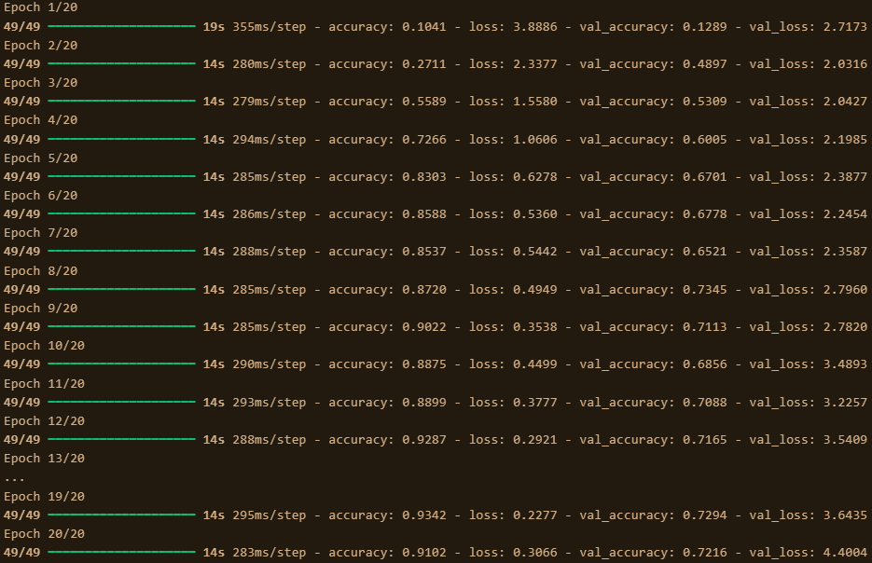
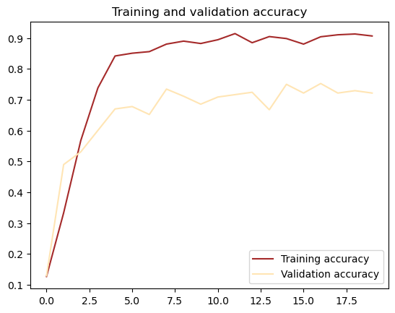
Training and evaluation
Trained the model for 20 epoch and created the model with training accuracy of 91%.
The graph shows the training and validation accuracy of the model.

Slide 6

Heart Disease Detection
Creating a Logistic Regression model to classify if person has a heart disease or not based on the textual information.
CSV file consist of 1190 records and 12 attributes.

Slide 7
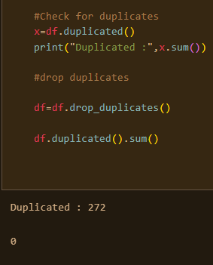
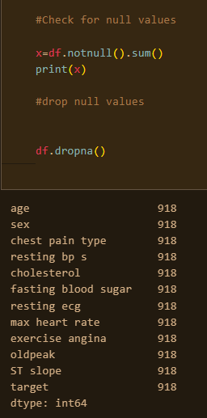
Data Pre-processing
First, remove the duplicate records
Second, check for null values in dataframe.
Finally, segregate labels (target) and other attributes seperately.

Slide 8
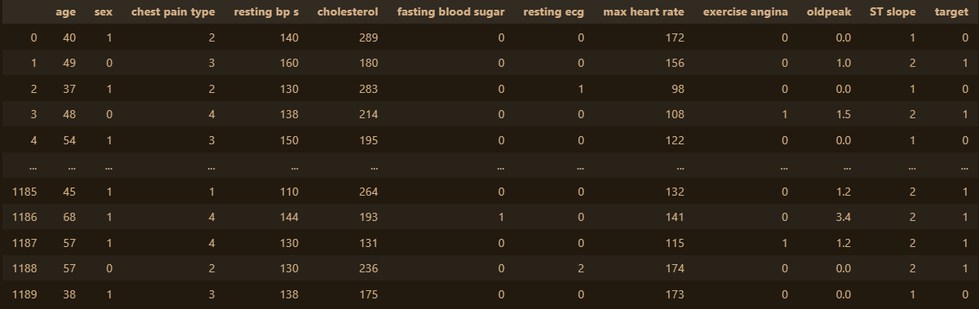
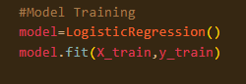
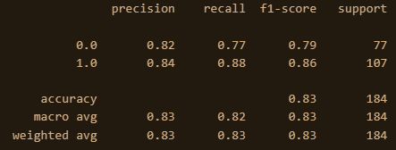
Created and trained the model using sci-kit learn package and created the model with accuracy of 83% and good f1-score.
Training and evaluation
Usage of classification report function to show the performance of our model

Slide 9

Mobile Phone Pricing Prediction
Creating a K Nearest Neighbor model to classify the price of mobile phone based on price segments.
CSV file consist of 2000 records and 21 attributes.
Price segments are classified into 4 segments.

Slide 10
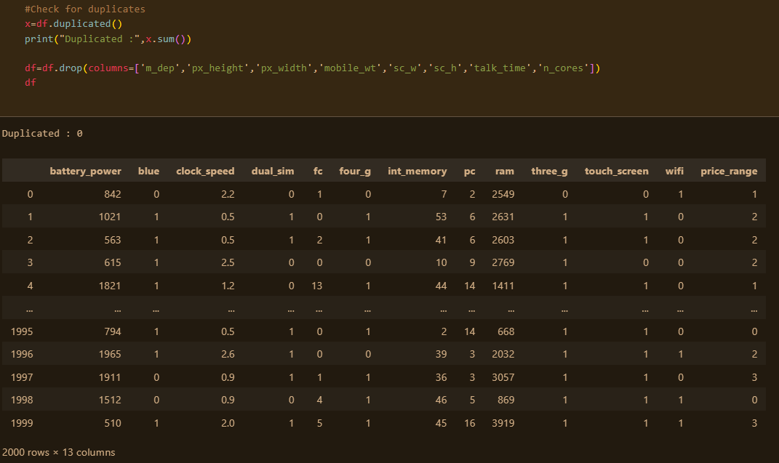
Data Pre-processing
First, check for duplicate records and removing unwanted attributes from dataset.
Attributes which are removed are 'm_dep', 'px_height', 'px_width', 'mobile_wt', 'sc_w', 'sc_h', 'talk_time' and, 'n_cores'
Finally, check for null values. Segregate labels (target) and other attributes.

Slide 11
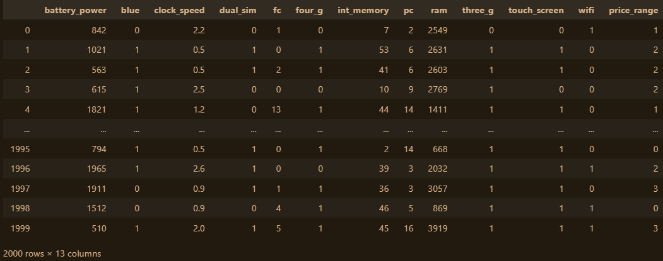
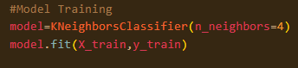
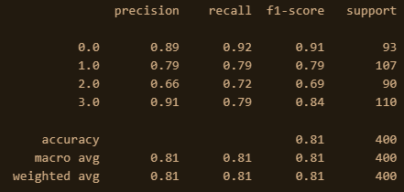
Created and trained the model using sci-kit learn package and created the model with accuracy of 81% and good f1-score.
Training and evaluation
Usage classification report function to show the performance of our model

Slide 12
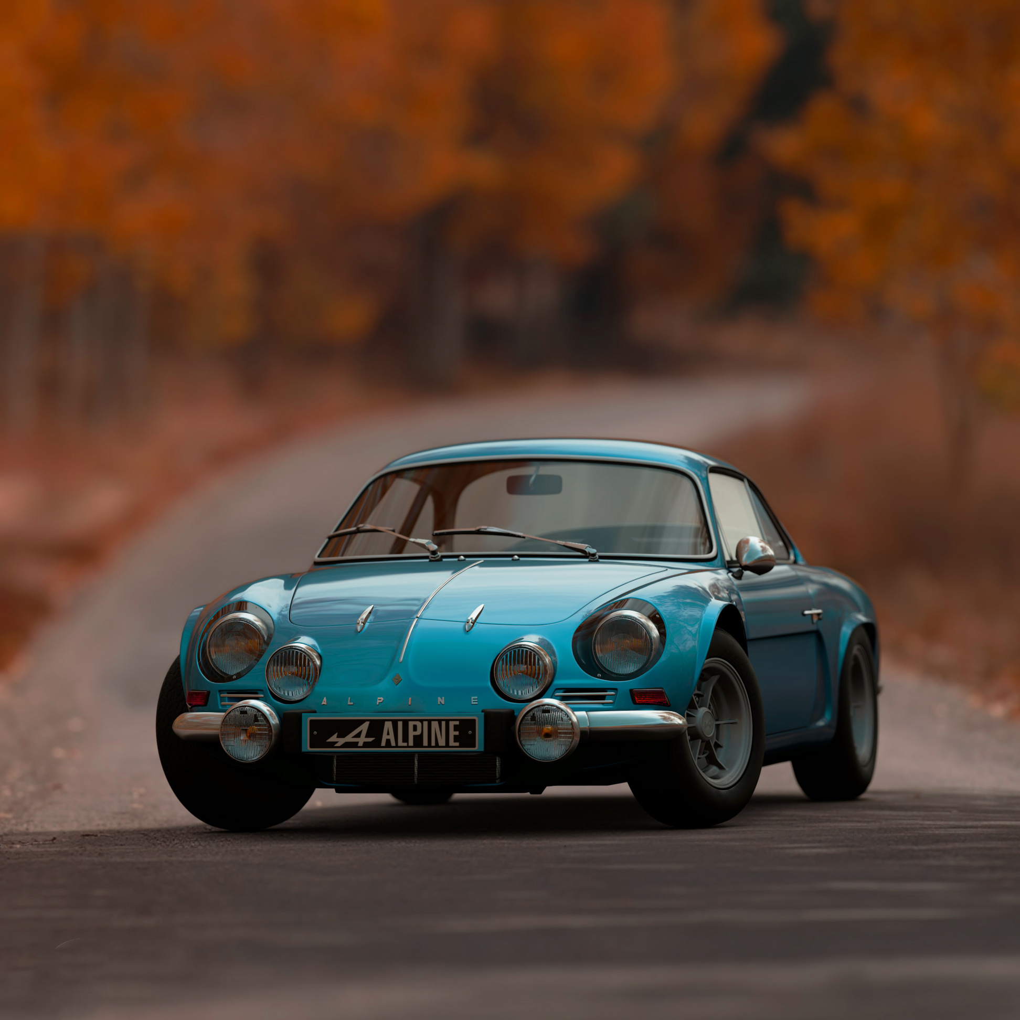
Vehicle Prices Prediction
Creating a Random Forest Regression model to predict the price of mobile phone based on price segments.
CSV file consist of 1002 records and 17 attributes.
Price segments is predicted using this model.

Slide 13
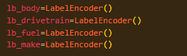
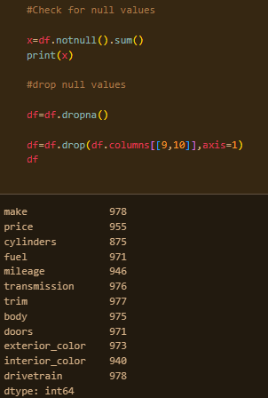
Data Pre-processing
First, check for duplicate records and removing unwanted attributes from dataset.
Check for null values and remove them.
Finally, we change categorical data to numerical data. Segregate labels (target) and other attributes.

Slide 14
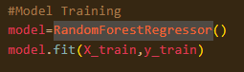
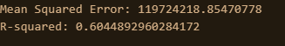
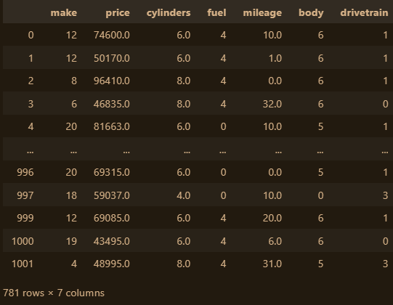
Training and evaluation
Created and trained the model using sci-kit learn package.
MSE and r2-score is used to show the performance of our model.

Slide 15
Thank
You

